Slide 1

Course Code | : | 19CSPN6401
Course Title | : | Mini Project
Team Number | : | 22BCSB011
Domain | : | IOT
Title | : | LED SERVO DISTANCE INDICATOR
Guide | : | Mr.P.Seethamani, AP/CSE
Team Members | : | 20BCS028 | - | RATHIDEVI.P
 |  | 20BCS054 | - | ARUNIKA.J
 |  | 20BCS090 | - | RISHIKESH.G

Slide 2
Contents
Problem Statement
Survey on Existing System
Objective
Block Diagram of Proposed System
Software and Hardware Requirements
References
Weekly Plan
Online Certification Courses

Slide 3
Problem Statement
The development of “smart cars” requires new sensors that are able to measure distances in the range of a few centimetre to a few meters.
Parking aids,For blind persons to walk By detecting obstacles , car reversing and headlight level are some example features that require a distance measurement to be performed with contactless sensors.

Slide 4
Survey on Existing System
Title | Source(Website) | Year | Inference
Servo distance Indicator | https://www.researchgate.pdf | 2020 | Distance indicator using servo motor
Purpose of ultrasonic sensor | https://create.arduino.cc/projecthub/49385/distanceindicator-using-ultrasonic-sensor-0d1c94 | 2019 | Distance measurement Using Ultrasonic sensors
Paper propesed For indicating distance using LED | https://iarjset.com/wpcontent/uploads/2021/07/IARJSET.2021.8723.pdf | 2021 | Distance indicator using LED
Pin configuration in node mcu | https://randomnerdtutorials.com/esp8266-pin.pdf | 2020 | Features of node mcu
Distance indicator using sensor and lcd | https://maker.pro/arduino?/projects/distancemeasurement | 2018 | Distance indicator using LCD

Slide 5
Objective
Develop a contactless sensor that are able to measure the obstacle distance From a vehicle or an object .
Led light blows and buzzer sounds when the obstacle come closer and the distance is display in the lcd display.
It helps in parking aid and also helps for blind persons to walk on a road by detecting the obstacles.

Slide 6
Block Diagram of Proposed System
NODE MCU
[ESP8266]
LED
DC power supply
BUZZER
Ultrasonic sensor
LCD display

Slide 7
Software and Hardware Requirements
Hardware | Software
1)NODE MCU [ESP8266] | 1) Arduino IDE
2) Breadboard | 2) Embedded C
3) Ultrasonic sensors
4) Jumper wires
5) LED lights
6) Buzzer
7) LCD display
8) Servo motor

Slide 8
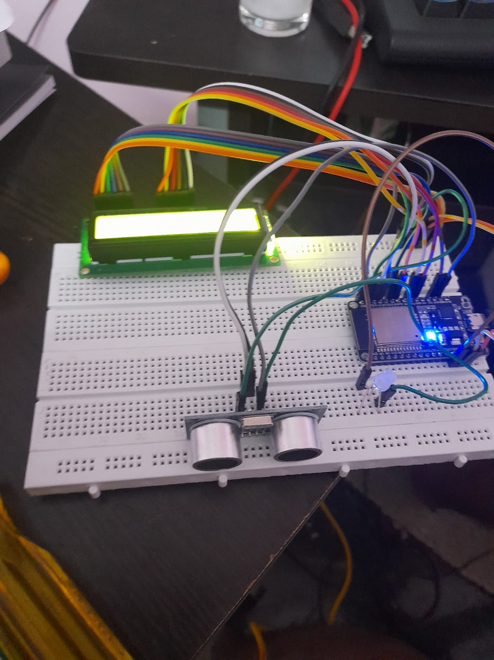
PROPOSED SYSTEM

Slide 9
References
https://create.arduino.cc/projecthub/anukulnikhil/distance-measurement-5102a0
https://create.arduino.cc/projecthub/brillianttechnoz/led-distance-measurement-using-ultrasonic-sens or-and-aurdino-4480f6
https://youtu.be/DF1WGZyAnoE
http://www.instructables.com/
https://iarjset.com/wpcontent/uploads/2021/07/IARJSET.2021.8723.pdf
https://robu.in/arduino-pin-configuration

Slide 10
Weekly Plan
Week 1 | : | Survey of Existing System
Week 2 - 3 | : | Block diagrams of Existing and Proposed Systems
Week 4 | : | Resource Set up
Week 5 - 8 | : | Implementation
Week 9 | : | Result Analysis
Week 10 -12 | : | Report Preparation

Slide 11



Online Certification Courses
Name of the Student | Title of the Course | Organized By | Time Period (from – to) | Duration (Weeks)
20BCS028 RATHIDEVI.P | What is IOT? and Basics of IOT | Great learning | Feb 4th-march 5th | 4 weeks
20BCS054 ARUNIKA.J | What is IOT? and Basics of IOT | Great learning | Feb 4th-March 5th | 4 weeks
20BCS090 RISHIKESH.G | Interfacing with the Arduino | Coursera | April 1st- May 2nd | 4 weeks
Team Member 1 | Team Member 2 | Team Member 3
RATHIDEVI P | ARUNIKA J | RISHIKESH G

Slide 12
Guide Meeting
Date | Team Members Involved | Discussion Points
28.01.2022 | 20BCS028 – RATHIDEVI P 20BCS054 - ARUNIKA J 20BCS090 - RISHIKESH G | Problem statement
05.03.2022 | 20BCS028 – RATHIDEVI P 20BCS054 - ARUNIKA J 20BCS090 - RISHIKESH G | Ppt preparation
08.04.2022 | 20BCS028 – RATHIDEVI P 20BCS054 - ARUNIKA J 20BCS090 - RISHIKESH G | Project implementation

